Slide 1
NEED FOR HEALTH FOR AMERICAN CONSUMERS
NAME:
INSTITUTIONS:

Slide 2
INTRODUCTION
Consumer engagement with healthcare continue to increase
Consumer engagement-new channels accessibility to tracking and health data sharing (Lee 123).
Informed patients –better health outcomes and incurs low costs
Clinicians, health systems and plans (Turow 112).
Development of strategies for helping consumers on their need for health
Consumer preferences and attitudes help in supporting health behaviors, improving experience on customers and attaining better outcome (Barkema 7428).

Slide 3
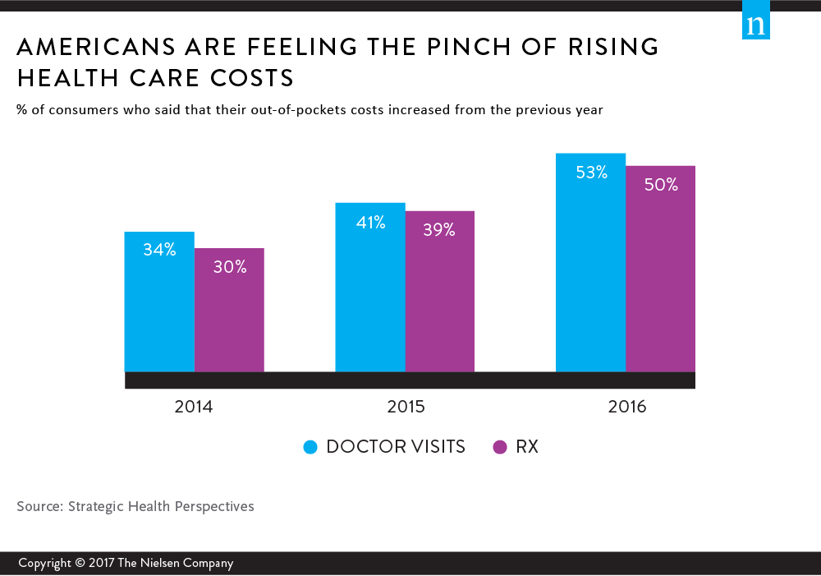
HEALTH CONCERNS FOR CONSUMERS
Cost
Quality
Information sharing
Mobile devices and other related technologies (Turow 121).
Pricing and quality
Convenience in healthcare services (Shi 321).

Slide 4

MAKING HEALTHCARE WORK BETTER
Improving the standards of healthcare industry
Investing healthcare prevention
Accountability in health insurance (Neff 121).
Reforms in comprehensive drug prescriptions
Transparency in prices for healthcare services
Preservation and control of competition (Neff 126).
Reducing and controlling the cost of quality healthcare

Slide 5
Conclusion
Good health for American consumers is an essential need
The government must ensure that the consumers are well protected and accessibility to good healthcare improved
There various methods that the government can use to improve health for the American consumers such as controlling cost and quality of healthcare in the country
Health improvement for American consumers helps in improving their accessibility and know-how relating to heath needs.

Slide 6
REFERENCES
Barkema, Herman Wildrik, et al. "Invited review: Changes in the dairy industry affecting dairy cattle health and welfare." Journal of Dairy Science 98.11 (2015): 7426-7445.
Lee, Kenneth, et al. "Dr Google and the consumer: a qualitative study exploring the navigational needs and online health information-seeking behaviors of consumers with chronic health conditions." Journal of medical Internet research 16.12 (2014).
Neff, Roni A., Marie L. Spiker, and Patricia L. Truant. "Wasted food: US consumers' reported awareness, attitudes, and behaviors." PloS one 10.6 (2015): e0127881.
Shi, Leiyu, and Douglas A. Singh. Delivering health care in America. Jones & Bartlett Learning, 2014.
Turow, Joseph, Michael Hennessy, and Nora Draper. "The tradeoff fallacy: How marketers are misrepresenting American consumers and opening them up to exploitation." (2015).

